Slide 1
Ministry of Foreign Affairs- Application

Slide 2
Introduction
The software development company based in Amman-Jordan that I work for as a software developer, has been awarded a project from an NGO(Non-Governmental Organization) that to help the government move faster towards their digital automation, and my company has been given multiple governmental ministries to choose from which are the Ministry of Health, Ministry of Finance, Ministry of Tourism, Ministry of Foreign affairs and finally the Ministry of Interior, and as the software developer I’ve been given upon, multiple of colleagues, and each one of us is required to come up with the application to solve it

Slide 3

Scenario

Slide 4
Problem definition and Solution
Here you have a list of items
And some text
But remember not to overload your slides with content
Your audience will listen to you or read the content, but won’t do both.

Slide 5
1.
Algorithm Definition

Slide 6
:
Algorithm Types:
1. Simple Recursive Algorithms:
2. Backtracking Algorithms:
3. Divide and Conquer Algorithms:
4. Brute Force Algorithms:

Slide 7
Steps from Code to Execution
Bring the attention of your audience over a key concept using icons or illustrations

Slide 8
Types of Paradigms
Object Oriented Paradigm.
Event Driven Paradigm
Procedural Paradigm

Slide 9
Problem Definition
While seeing the services that the Ministry of Foreign Affairs offers the Jordanian population that’s out of jordan, It was found that whether there’d be a citizen that lives abroad that wants to renew their ID or Passport, or a foreigner applying for a visa to visit family, or work, or just to see jordan the Ministry of Foreign Affairs plays the unnecessary middle man role between the people and the designated sector. As aforementioned above that their role as the middleman is unnecessary and considering the number of people that use this service, cutting out the Ministry of Foreign Affairs from their role as there middle man will serve a great step in automating the process of the government while also relieving the Ministry from its unimportant role.

Slide 10

Design Document

Slide 11
Wireframes

Slide 12

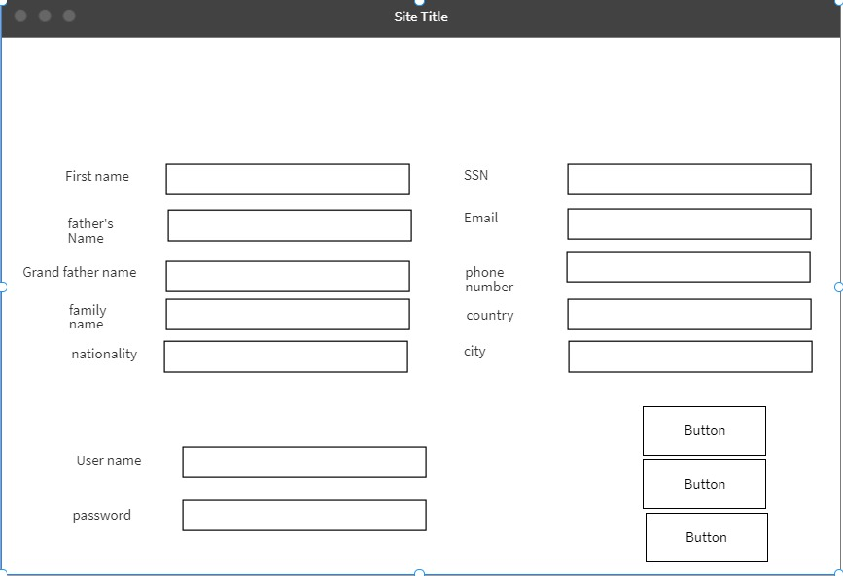

Slide 13
Mock-Ups

Slide 14
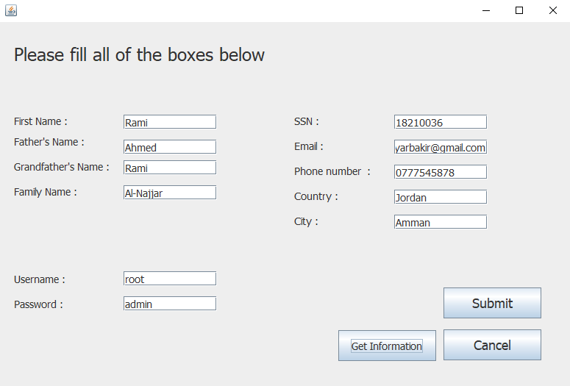

Slide 15
View Map

Slide 16
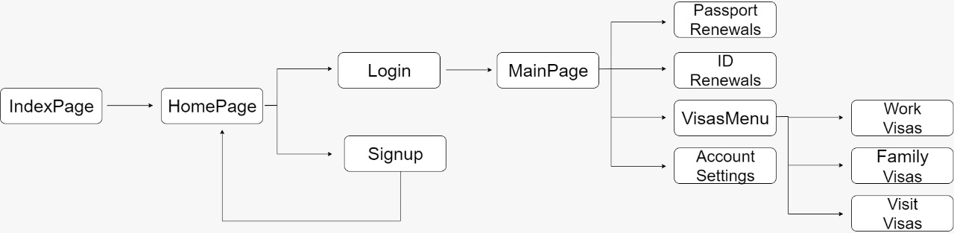

Slide 17
Thank You for listening

